Slide 1
Agenda 11/3
Expanding Chrome Extension to…
…manipulate images in a Webpage
…add p5.js graphics on top of a Webpage

Slide 2
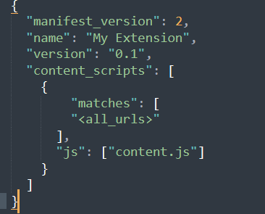
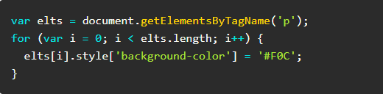
Our first Chrome Extension
Using Sublime Text create the following files
manifest.json
content.js
Save them in the same folder
content.js
This is the code to modify the HTML pages
manifest.json

Slide 3
Our first Chrome Extension
Go to “chrome://extensions/” in your Chrome Browser
Turn on Developer Mode
Click on ‘Load Unpacked’ and navigate to your folder
Now all <p> tags should be pink!!!
Try changing colors, text weight of other tags!

Slide 4
Other text alterations
document.body.innerHTML = document.body.innerHTML.replace(/Michigan/g, "Mars");
Will change all occurrence of ‘Michigan’ to ‘Mars’

Slide 5
Finding & using tags in a Webpage
Types of HTML Tags: https://www.w3schools.com/TAGS/default.ASP
var pageImages = document.getElementsByTagName('img');
This lines goes in content.js

